Slide 1

HACKATHON PROJECT
POWDER MIXING
QUALITY ASSURANCE
Recipe-Based Batch Evaluation & Ingredient Tolerance Validation
Team Name: TEAM-20
Raavi Jahnavi-2420030173
Thirumala Reddy Sagar Mounitha-2420030330
SriHansika Saraf-2420030556
A practical tool for accurate, consistent and traceable powder batches

Slide 2
The Problem
02
Why powder mixing needs reliable quality checks
CHALLENGES
WHAT IS NEEDED?
Manual weighing can introduce errors.
A clear recipe target for every ingredient.
Small percentage deviations can affect batch consistency.
Automatic calculation of actual percentages.
Checking every ingredient by hand takes time.
Tolerance-based pass/fail decisions.
Inconsistent records make decisions harder to trace.
A simple interface for operators and reviewers.

Slide 3
Our Solution
03
A lightweight web application for batch-level quality assurance
The Powder Mixing Quality Assurance System compares the actual weight of each ingredient against its saved recipe target and tolerance.
01
02
03
04
Save recipes
Enter weights
Evaluate batch
Get a decision
Define ingredients, target percentages and allowed tolerance.
Record the actual grams measured for a batch.
Calculate ingredient percentages and check deviations.
Return APPROVED or REJECTED with a message.

Slide 4
Key Features
04
Designed around the practical workflow of recipe and batch control
01
02
03
Recipe management
Target validation
Tolerance checks
Create, view, edit and delete recipes.
Ensure recipe targets add up to 100%.
Validate each ingredient against its permitted deviation.
04
05
06
Batch decisions
Persistent storage
Dashboard summary
Show a clear APPROVED or REJECTED outcome.
Store recipes and evaluated batches in MySQL.
Display recipe and batch decision counts.

Slide 5
How It Works
05
From a saved recipe to a batch decision
1
Select recipe
Load ingredient targets and tolerances.
2
Enter actual weights
Input the measured weight in grams.
3
Calculate percentages
Actual % = ingredient weight ÷ total batch weight × 100.
4
Compare tolerance
Check each actual percentage against its permitted range.
5
Return decision
Approve only when all ingredients pass.

Slide 6
System Architecture
06
Simple separation of user interface, business logic and data storage
FRONTEND
BACKEND API
DATABASE
HTML • CSS • JavaScript
→
Java • Spring Boot
→
MySQL • Spring Data JPA
Recipe forms, weight inputs, results
Validation, tolerance evaluation, decisions
Recipes, ingredients, batch records
REST endpoint: POST /api/batches/evaluate
JSON request → evaluation service → database persistence → JSON response

Slide 7
Technology Stack
07
Tools and frameworks used to build the prototype
FRONTEND
BACKEND
DATA LAYER
RUNTIME & TESTING
HTML
Java 21
Spring Data JPA
Maven / IDE
CSS
Spring Boot
Hibernate
Browser-based interface
JavaScript
Spring MVC / REST
MySQL 8
API and end-to-end tests

Slide 8
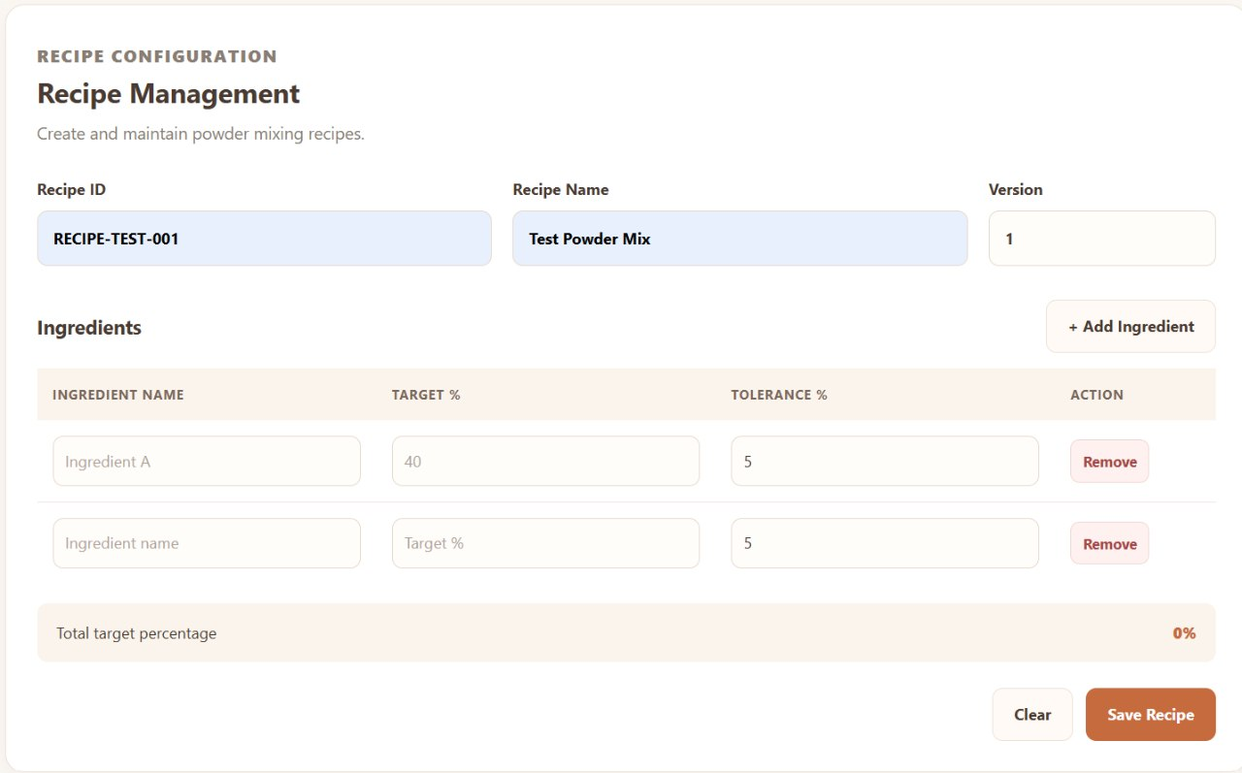
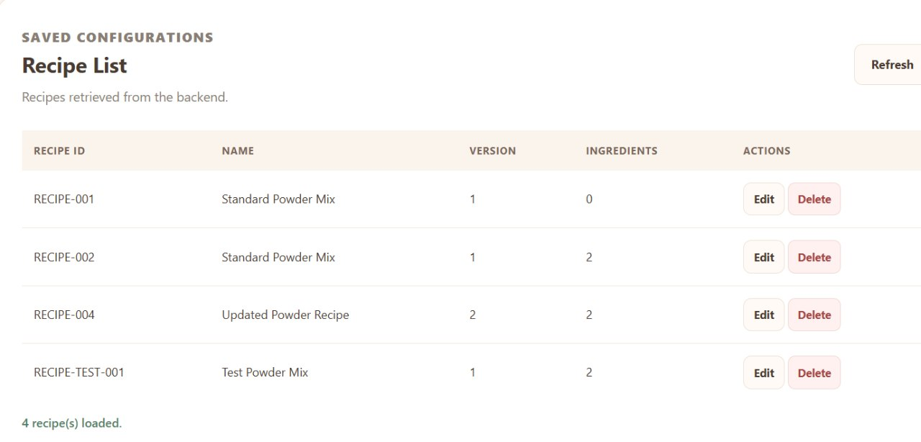
Results & Validation
08
RECIPE MANAGEMENT
RECIPE LIST
Insert recipe creation/list screenshot
Insert approved/rejected result screenshot

Slide 9
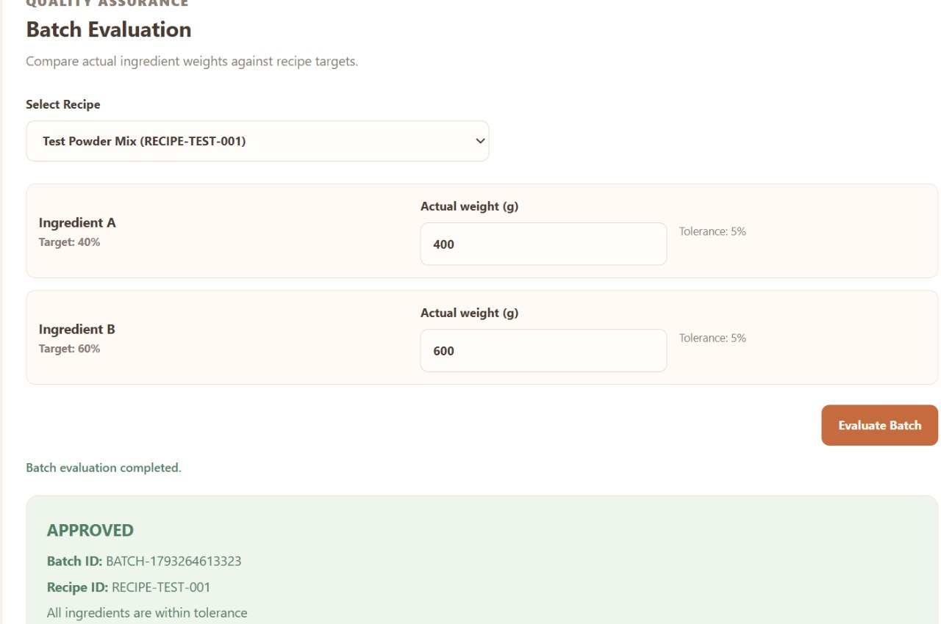
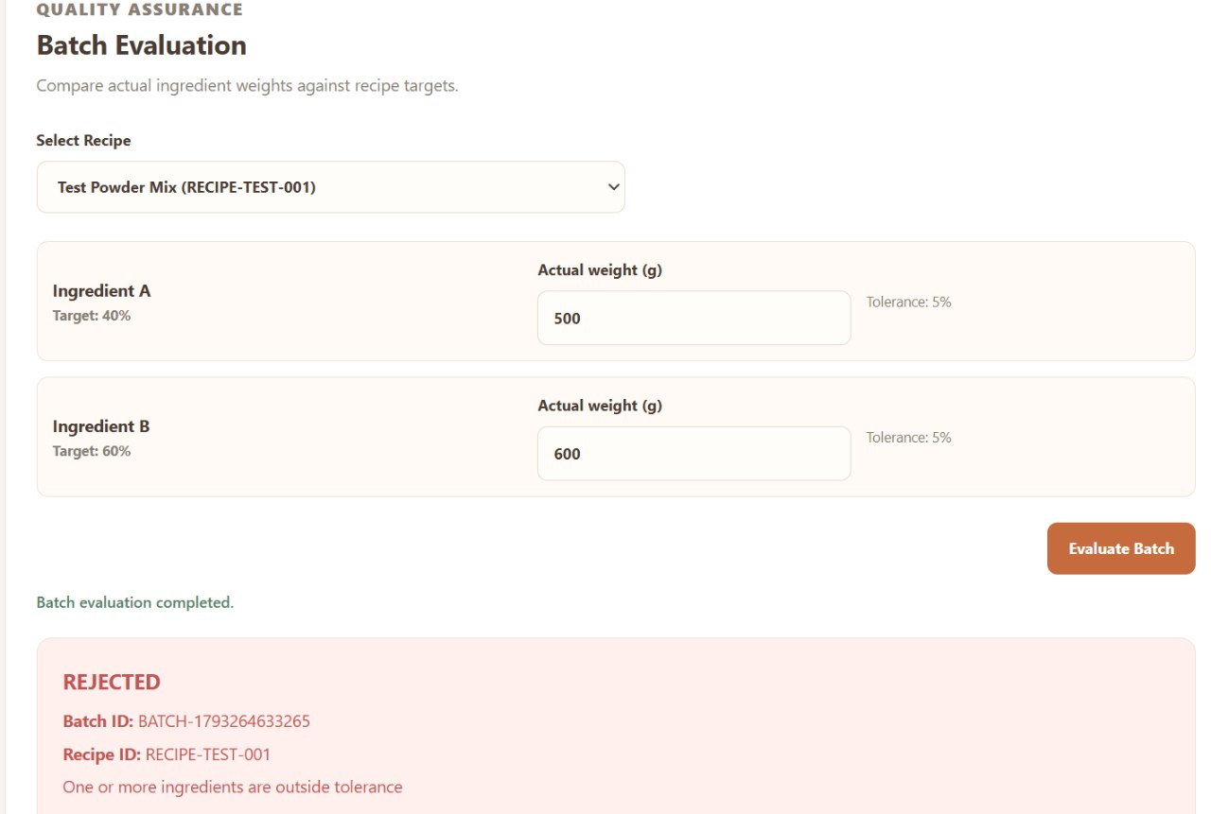
Results & Validation
09
BATCH EVALUATION

Slide 10
Impact & Future Scope
10
Value today and opportunities to expand
CURRENT VALUE
FUTURE ENHANCEMENTS
Reduces manual percentage calculations.
User login, roles and audit history.
Applies consistent tolerance rules.
Exportable batch reports (PDF / CSV).
Barcode or QR-based batch identification.
Provides a quick, understandable batch decision.
Weighing-scale integration and alerts.
Stores recipe and batch data for traceability.
Analytics for recurring deviations.

Slide 11
THANK YOU

